Slide 1




Traffic Guideline Compliance Audit – IIT Patna
Visual Assessment of Admin & Tutorial Block Zone and We've mentioned the solutions to the discrepancies as per the Reference of IRC.
Janvi Kumari -2201CE24
Khushboo Kumari – 2201CE25
Khushboo Kumari – 2201CE26
Kumar Anurag – 2201CE27
Kumari Shravani – 2201CE28
Kushagra Pandey – 2201CE29
Mayank Kumar – 2201CE31
Zeeshan Hasssan – 2201CE32
Mingkeng Libang – 2201CE33
Izhaan Khan – 2201CE34
Shivam Kumar – 2511TE04

Slide 2
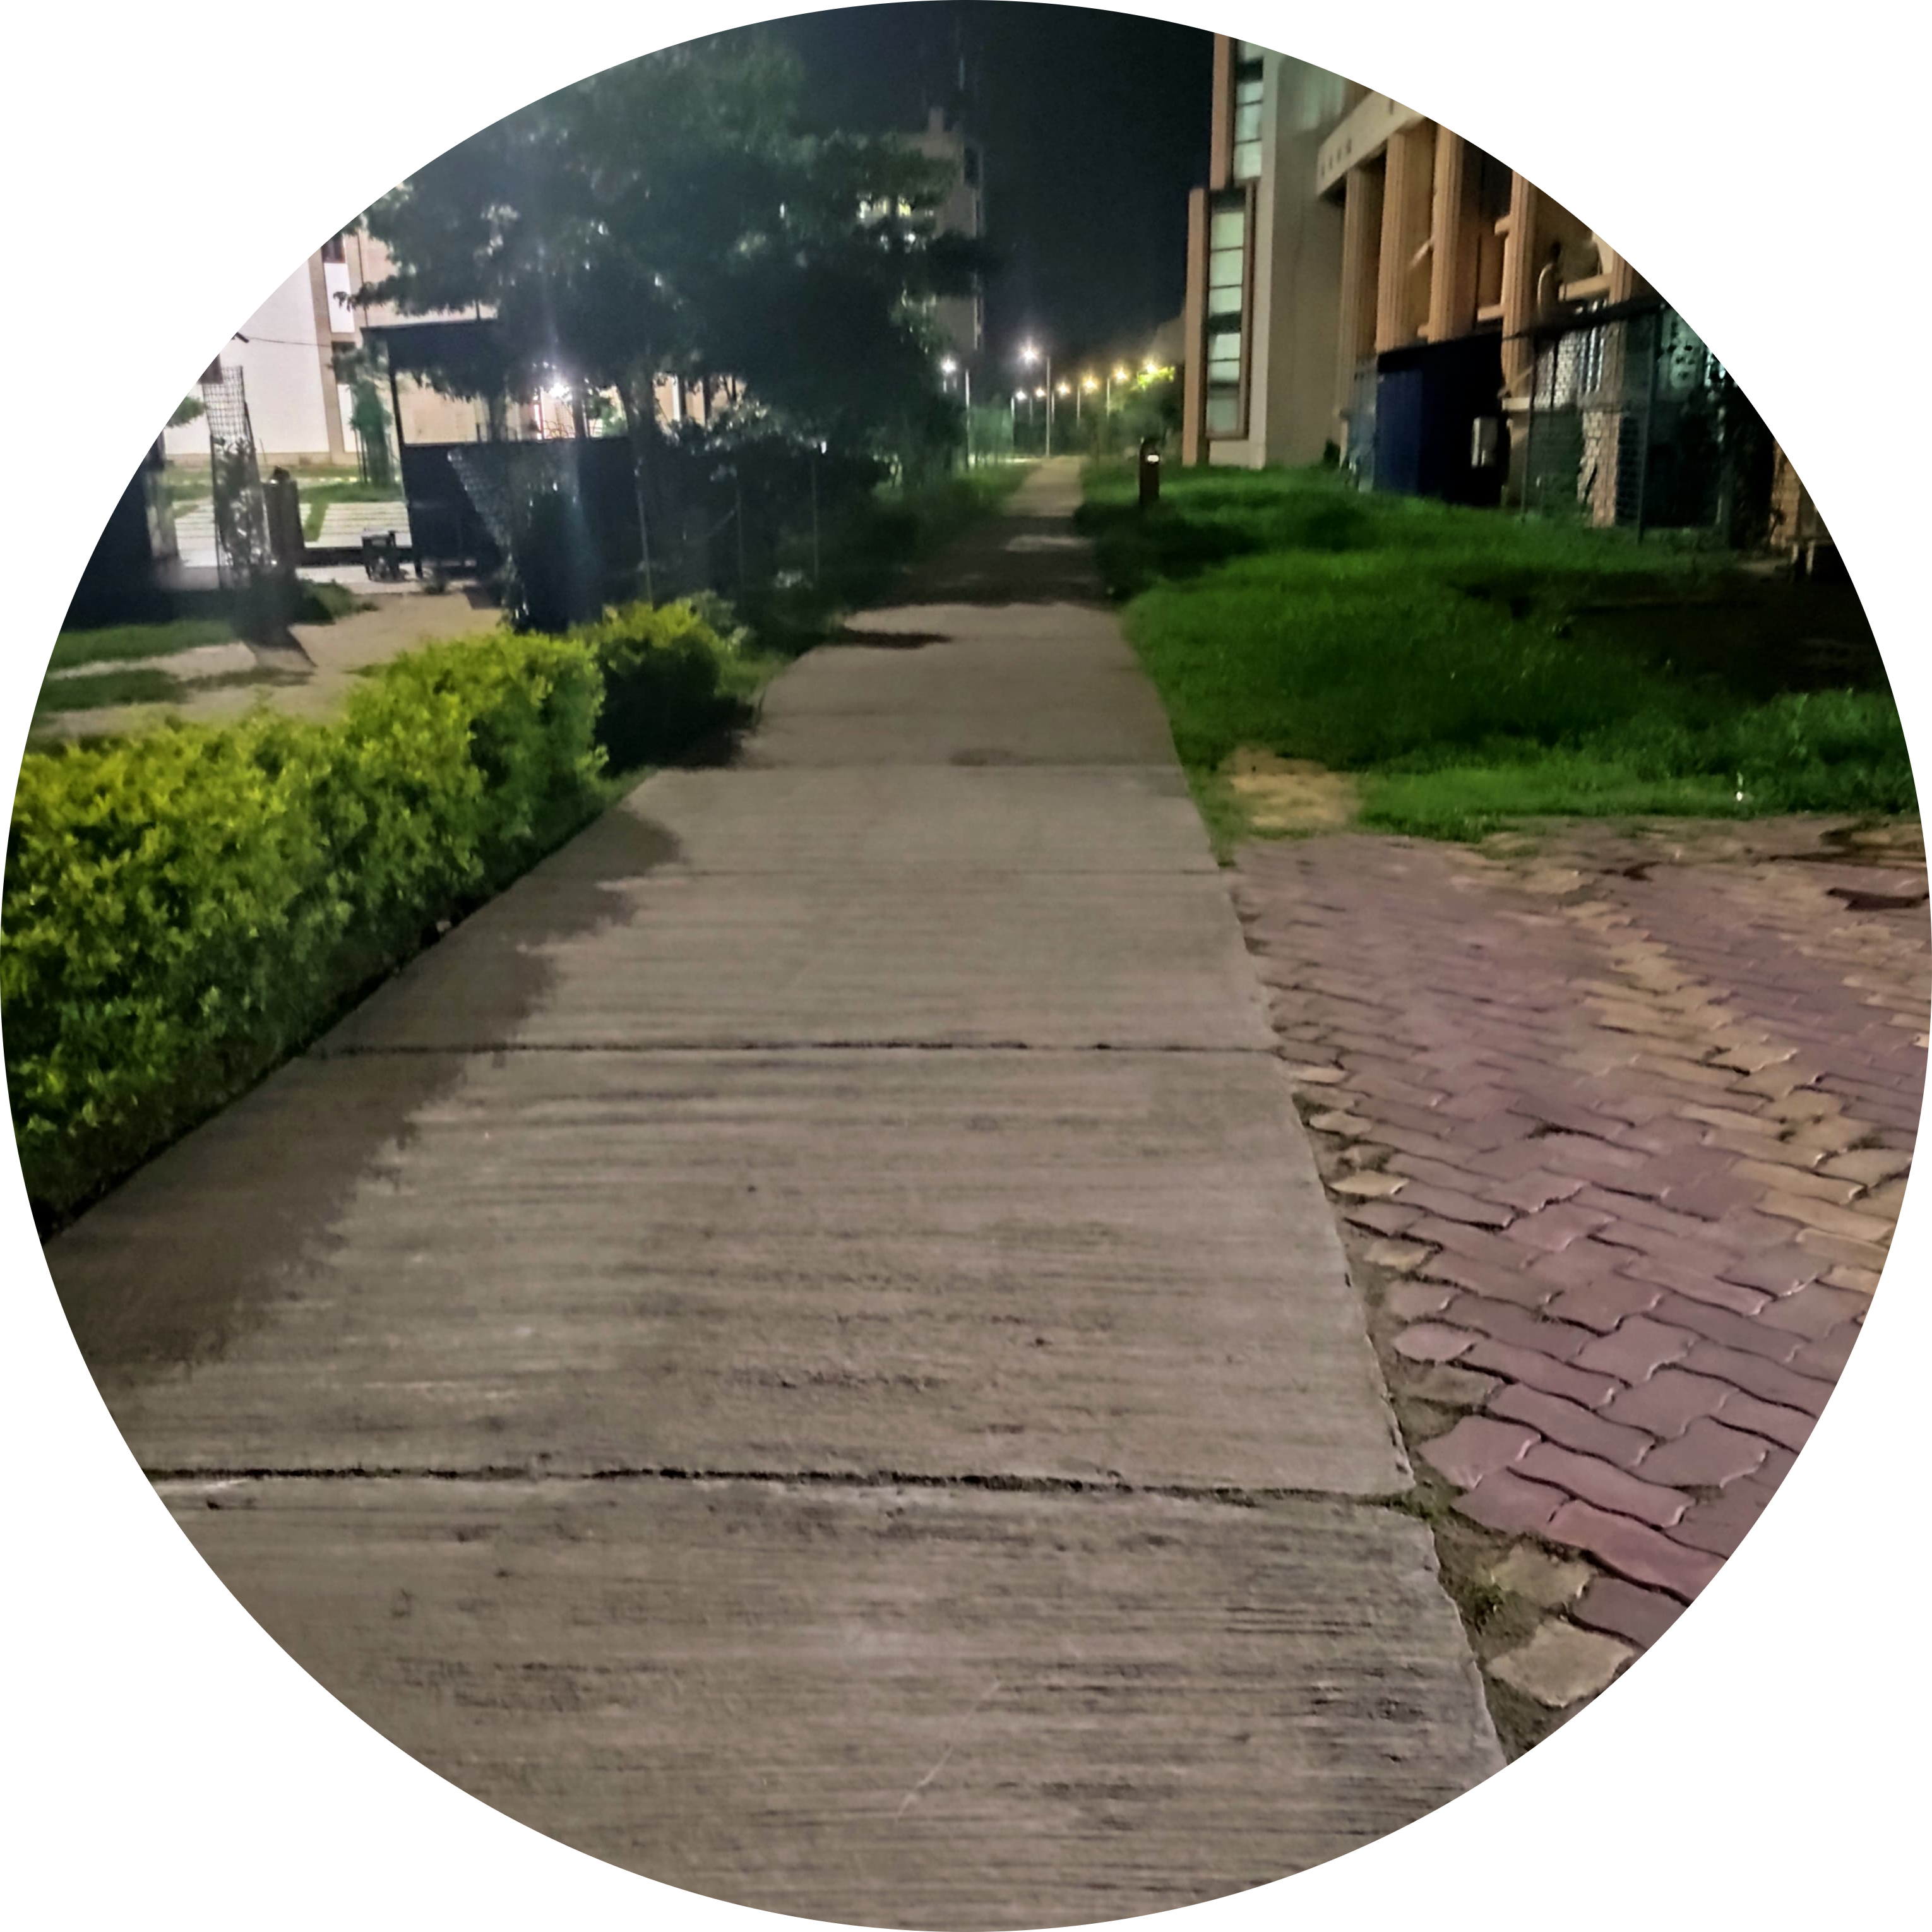
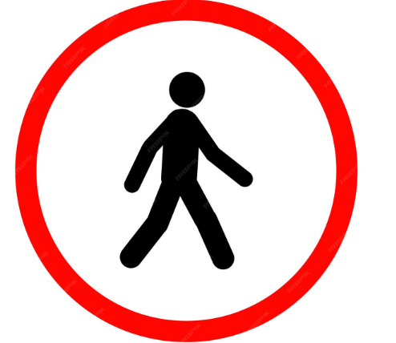
Location: Nescafe Tutorial
Block(Block 9)
Issue:No signboard indicating pedestrian-only zone.
Solution:iRC:67-2012 –Install ‘Pedestrian Only’ sign as per norms.
Compliance:NO

Slide 3



Location: Between Admin Block & Tutorial Block (IIT Patna)
Issue: Vehicle parked in non-designated area (on lawn) Solution: No Parking Zone Compliance: No

Slide 4
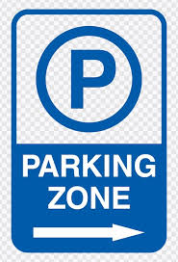
Location: Near Parking Zone, Tutorial Block
Issue: Clearly demarcated parking lines and space Solution: Proper Parking Area Compliance: Yes

Slide 5

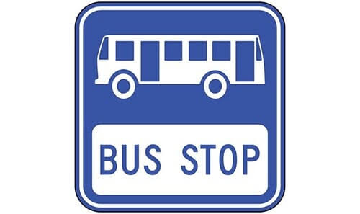
Location: Bus stop zone near Admin-Tutorial area
Issue: No proper 'Bus Stop' signage; broken bike nearby Solution: Standard Bus Stop Zone Compliance: No

Slide 6
Location: Near Tutorial Block
Issue: Improper roadside parking beside trash bin Solution: Proper Parking Zone Compliance: No

Slide 7
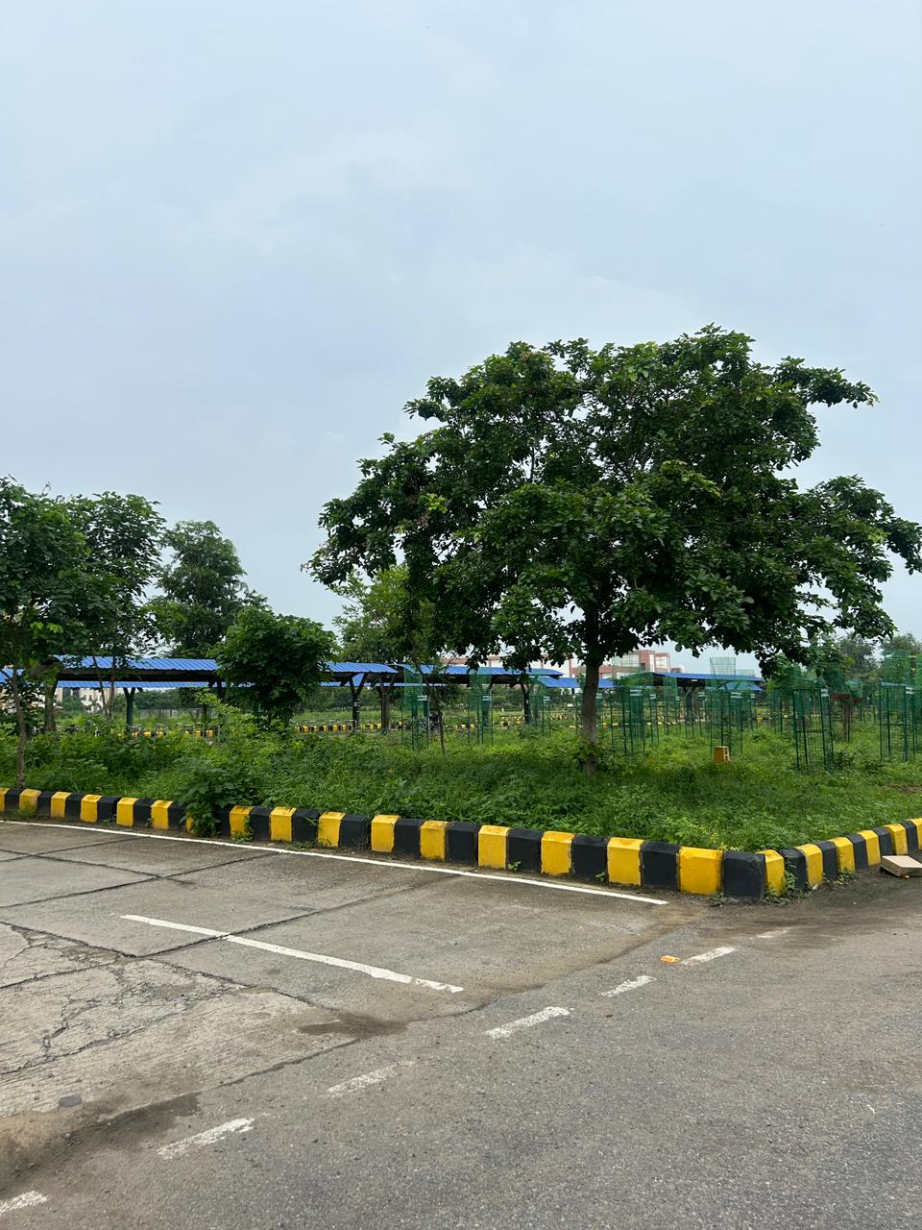
Location: Near Tutorial Block
Issue: Corner edge properly marked with yellow – black visibility curves Solution: Proper Edge Marking Compliance: Yes

Slide 8

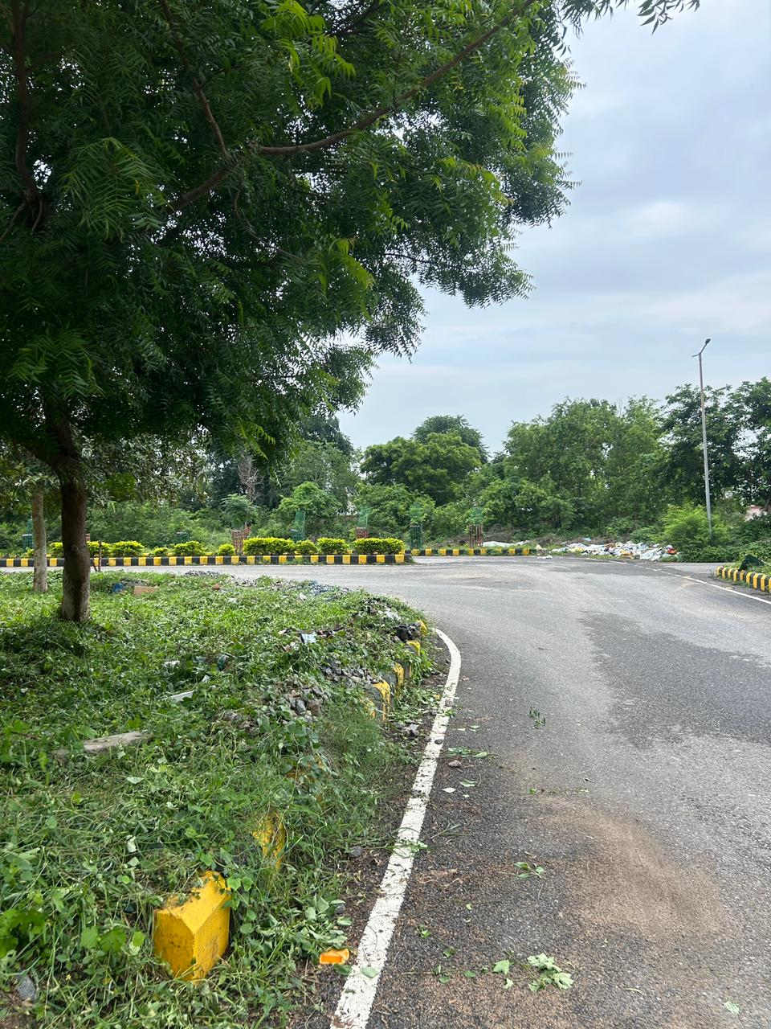
Location: Curved road behind Tutorial Block
Issue: No “Sharp Turn” or “Speed Limit” signage at a curved road section, which is a potential hazard Solution: IRC:67-2012 – Cautionary signage like curve and speed limit signs are mandatory for safe navigation
Compliance: No

Slide 9

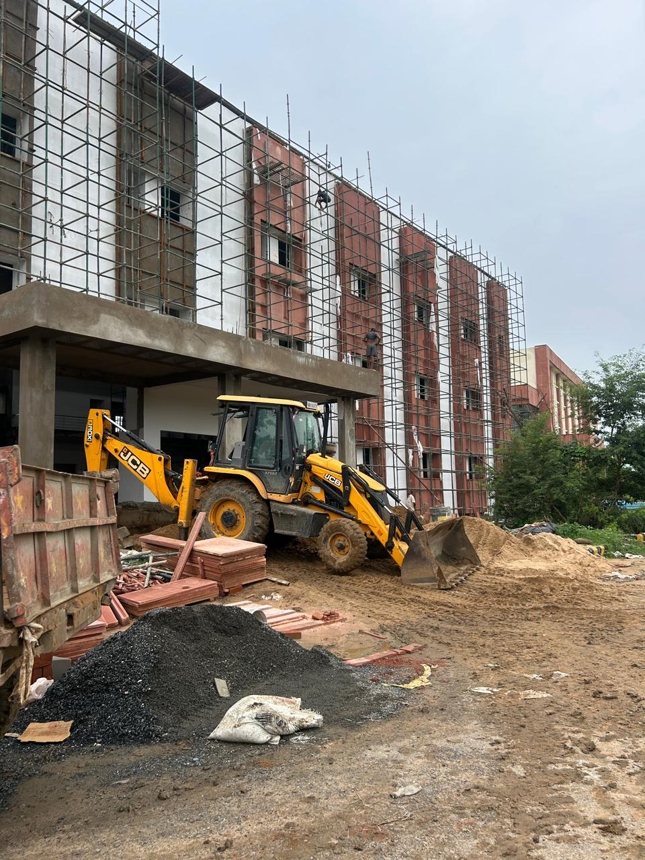
Location: Construction site adjacent to Block 6
Issue: No “Construction Ahead” or “Men at Work” signage; lacks barricades or traffic control around work zone Solution: IRC: SP: 55-2014 – Guidelines mandate clear temporary signage and barriers in work zones Compliance: No

Slide 10
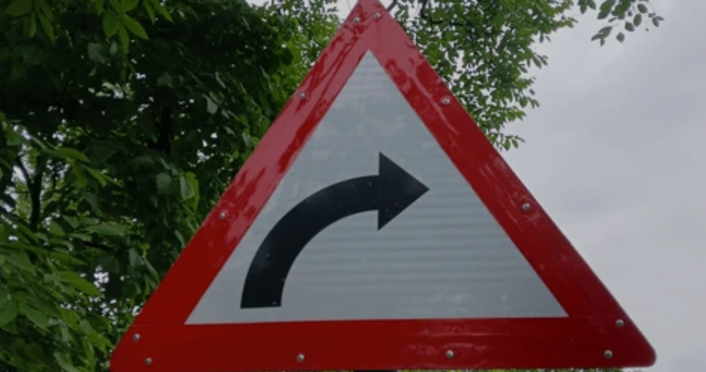
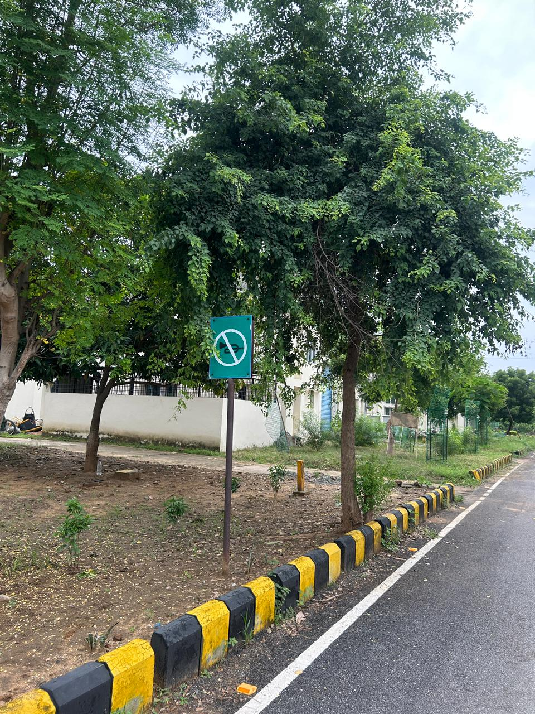
Location: Side of road near Block 6
Issue: "No Right Turn" sign is displayed (though incorrectly on a green board, which is meant for informational signs) Solution: IRC:67-2012 – Regulatory signs should ideally use circular red-bordered design Compliance: Partial (Sign present and interpretable, though design doesn't match standard)

Slide 11
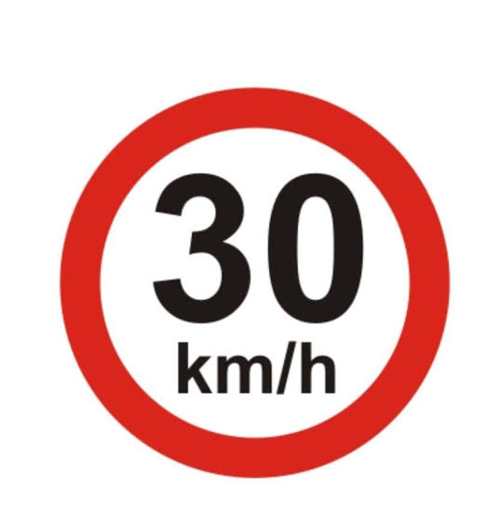
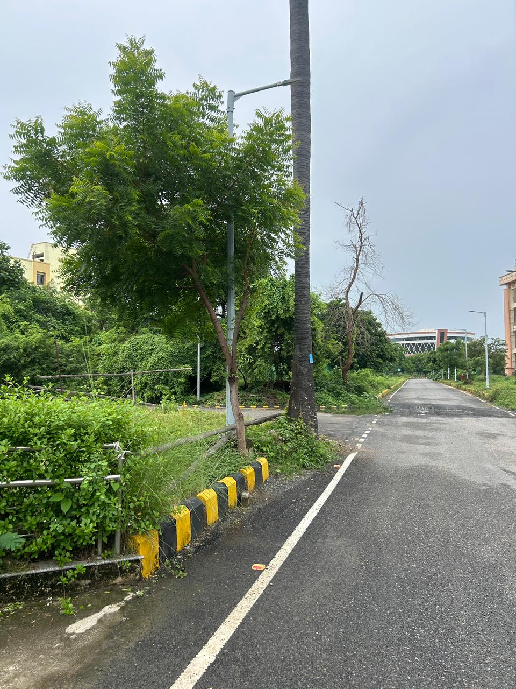
Location: Road behind Block 6
Issue: Poor road surface near turn; no speed limit or cautionary signage Solution: IRC:67-2012 – Hazardous curves or road condition changes must be accompanied by cautionary signage Compliance: No

Slide 12
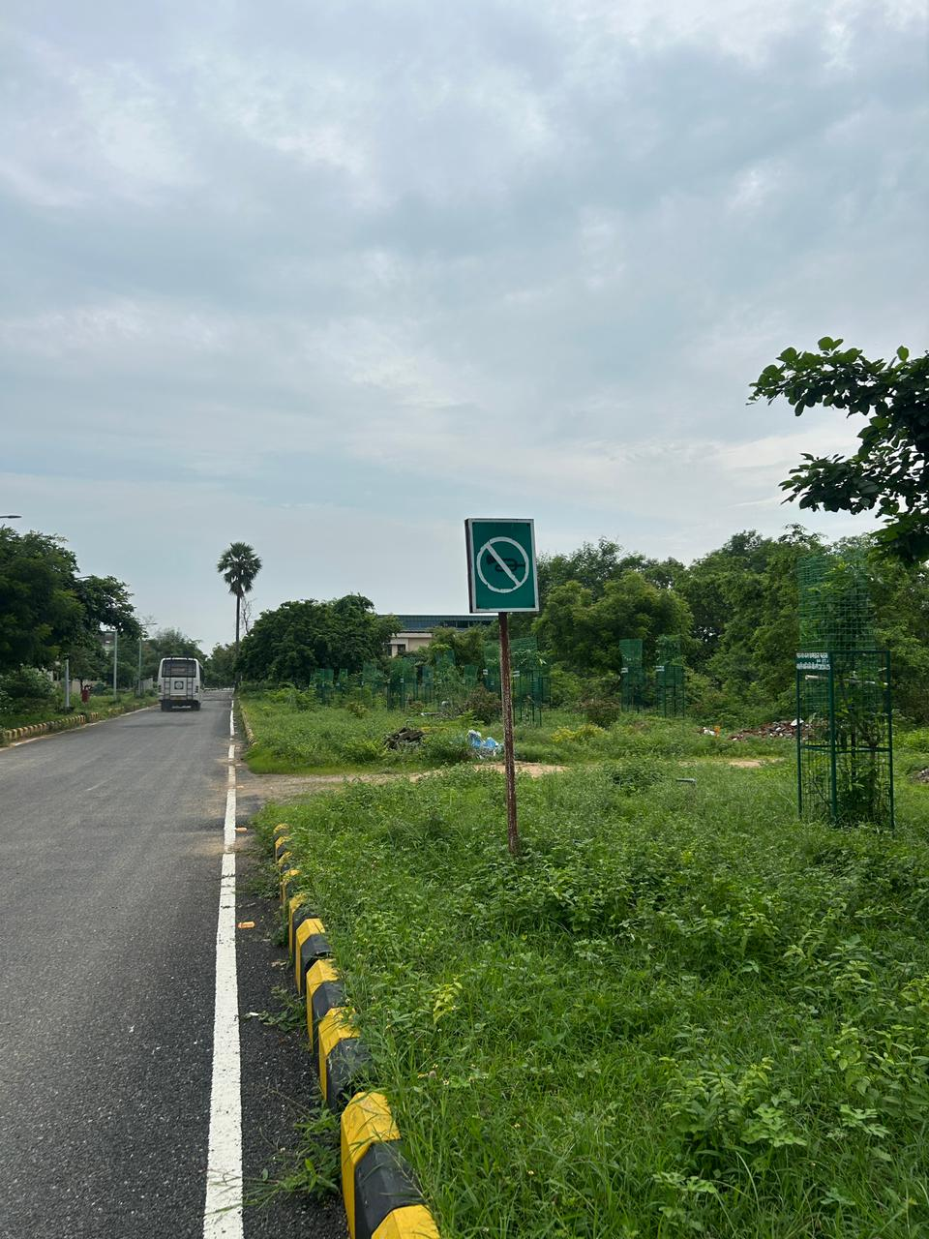
Location: Road near green patch behind Block 6
Issue: "No Right Turn" sign is present (design is again on a green board instead of red-bordered circle) Solution: IRC:67-2012 – Design non-standard but meaning clear Compliance: Partial

Slide 13
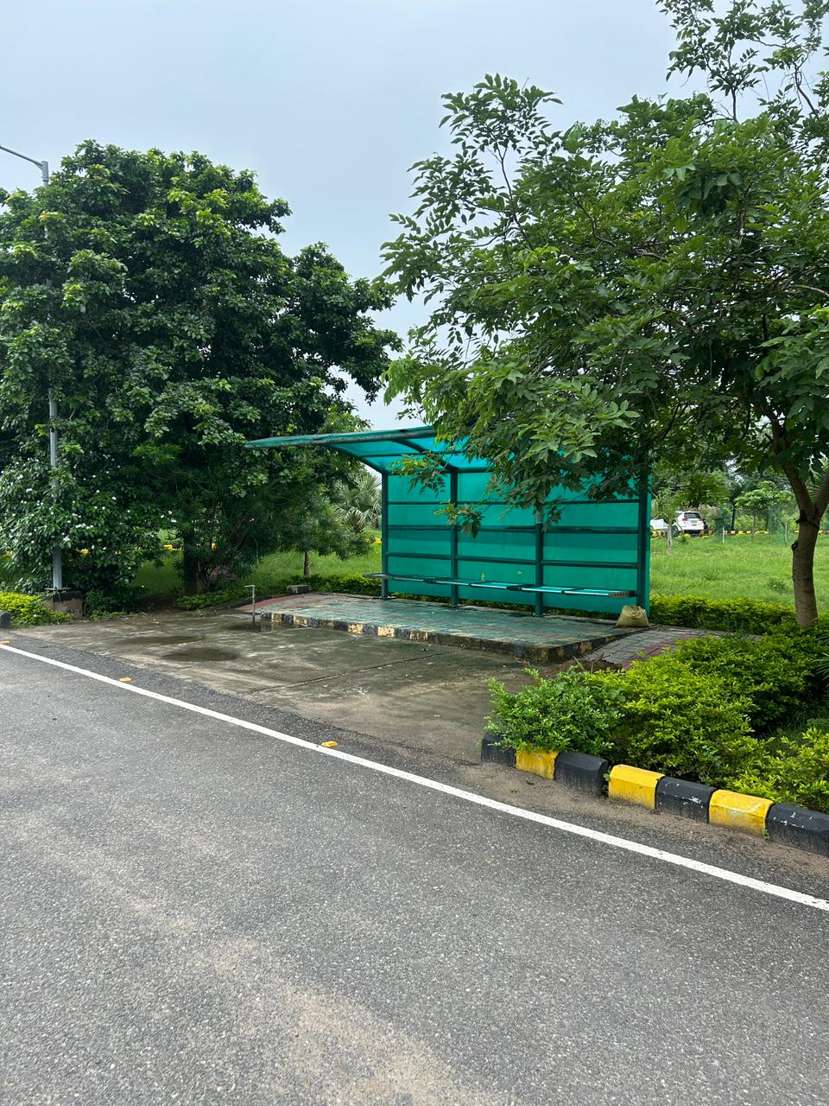
Location: Near Tutorial Block
Issue: No proper 'Bus Stop' signage Solution: Standard Bus Stop Zone Compliance: No

Slide 14
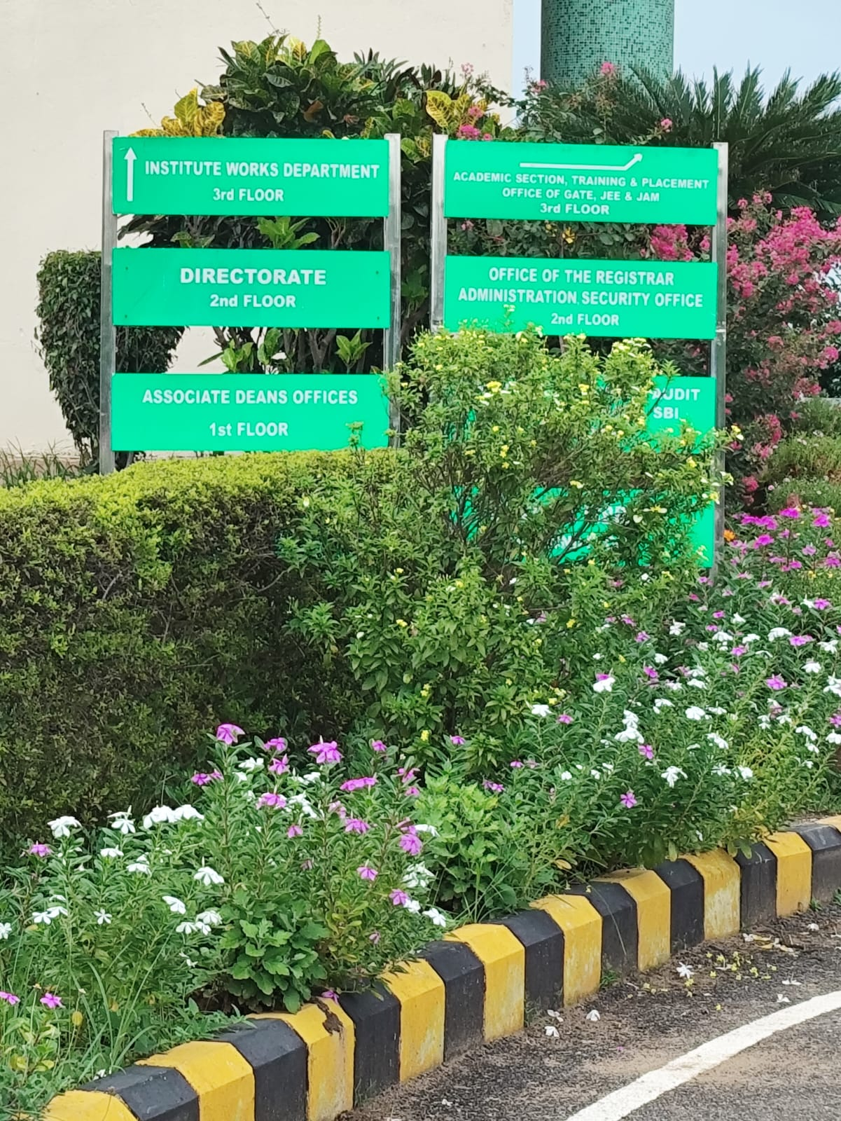
Location: Admin Block entrance
Issue: Building nameboards are present, but no traffic-related signs (like direction, parking, or warning signs) in sight Solution: IRC:67-2012 – Buildings accessed via roads should have directional signs, especially at forks or entry roads Compliance: Partial (informational signs only; traffic navigation signs missing)

Slide 15
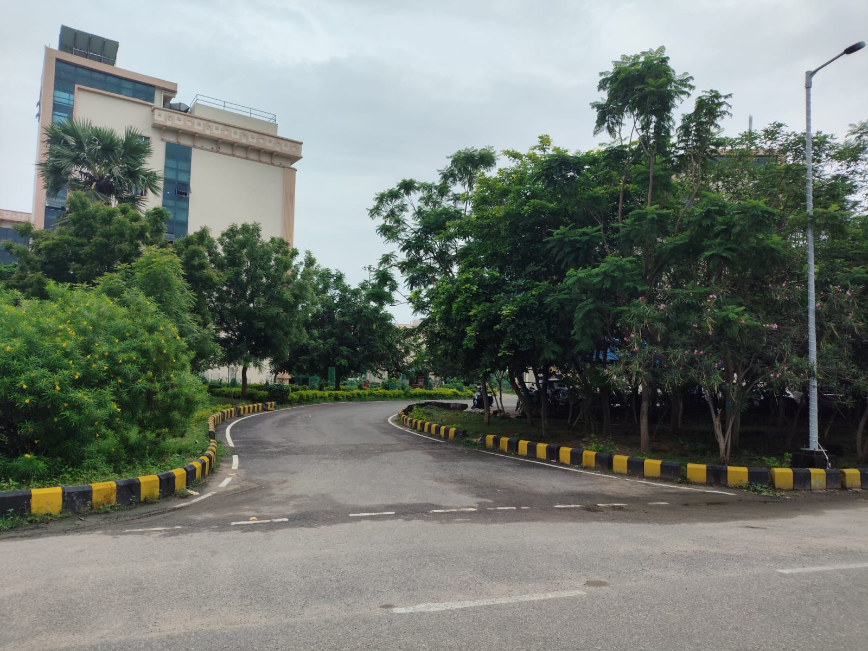
Location: Near Tutorial Block
Issues: No warning signage for upcoming curve
Solutions: IRC67-2012-Sharp bends or Curves must be indicated using “Right/Left curve”
Compliance :No

Slide 16
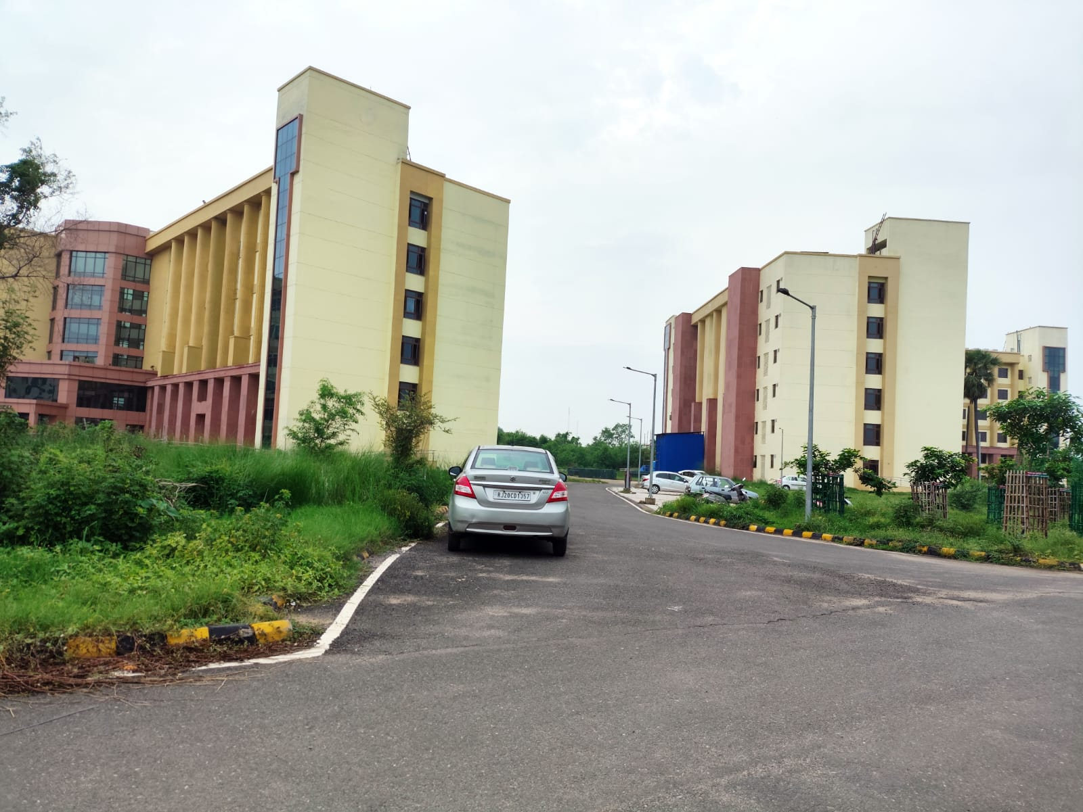

Location: Near Tutorial Block
Issues: Improper roadside parking
Solutions: Proper Parking Zone
Compliance: No

Slide 17
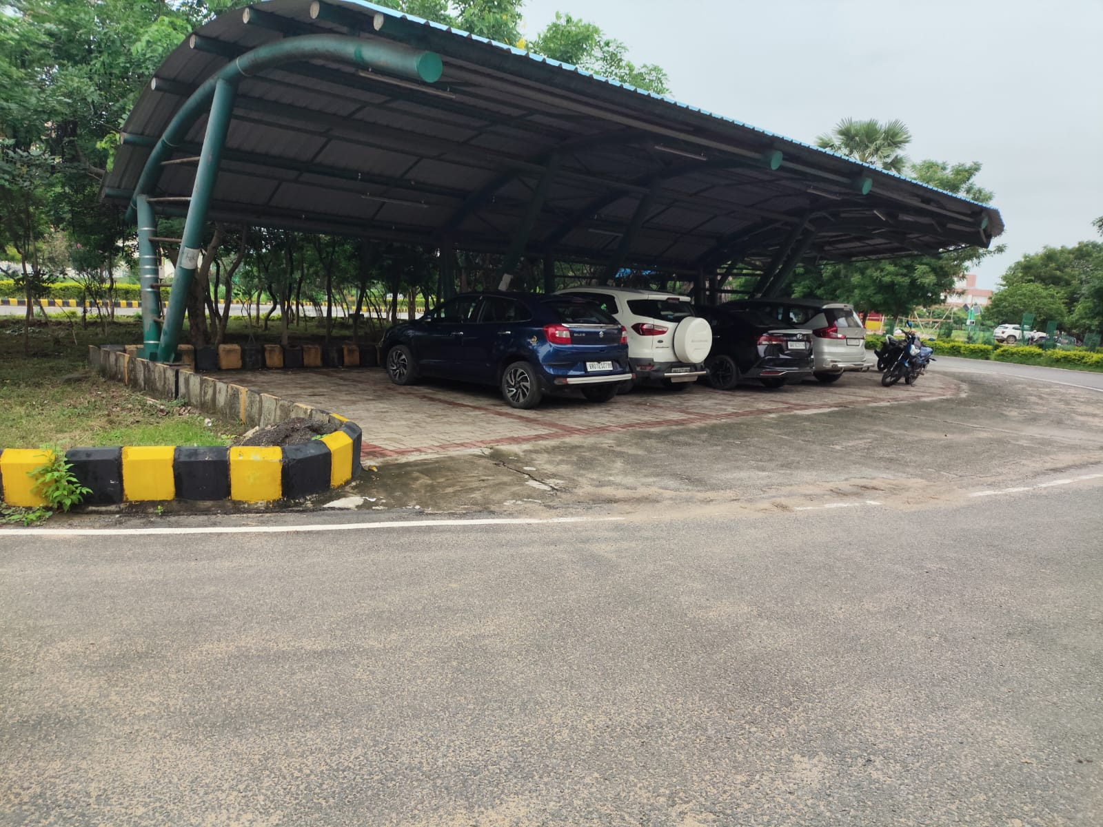
Location: Entry to parking zone near Admin Block
Issue: No “Entry”, “Parking”, or “Speed Limit” signage; turning radius reduced due to angle of parking layout Solution: IRC:67-2012 – Entry/Exit points should have signs like “Parking”, “Entry”, and “Speed Limit” especially at curves
Compliance: Yes but not speed limit

Slide 18
THANK YOU

